Slide 1
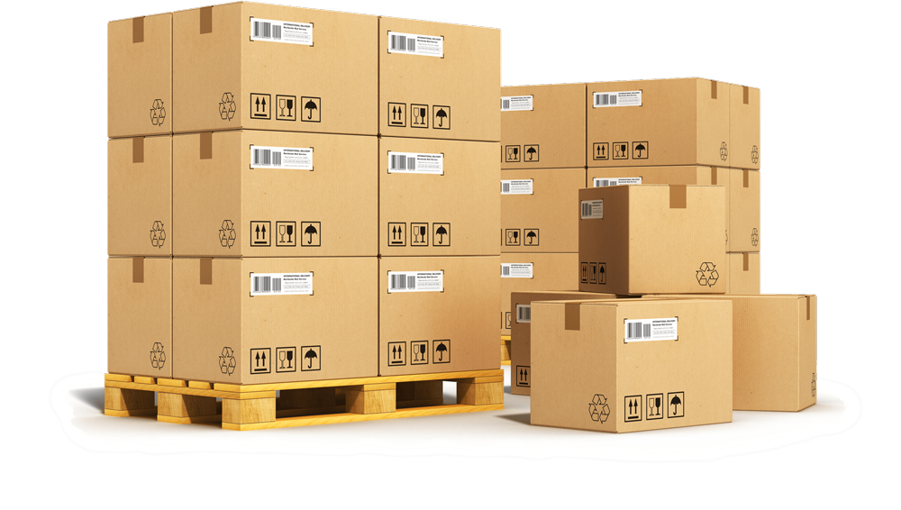
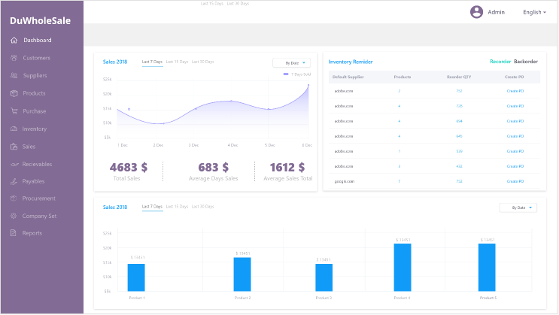
Durbin labs limited partnership with Habro Systems limited Presents
DuWholesale
A complete software solution for wholesale and distribution
DuWholesale

Slide 2
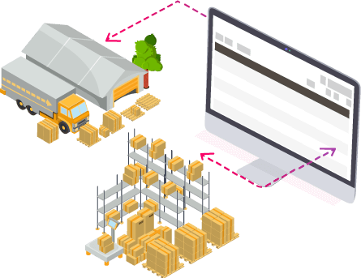
DuWholesale
Multi-channel Order, Inventory and
warehouse management with accounting.
Web
Application
Mobile
App
Cloud
E-commerce
Integration
POS
Integration

Slide 3
DuWholesale
Manage imports & exports
Manage back to back orders
Generate quotation & sales easy
Keep your stock levels in check
Know your every historical company data
Customer & product information at the fingertips

Slide 4
Inventory management
CRM
Product Management
DuWholesale
Purchase Management
Warehouse Management
Supply Management
Oder management

Slide 5
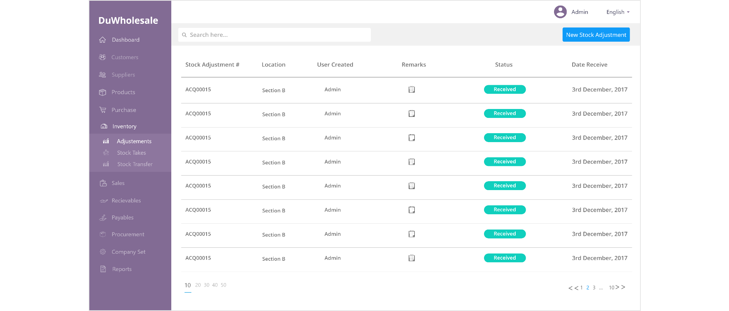
DuWholesale
Inventory Management
Inventory Listing
Product History
Damage Adjustments
Barcode Inventory
Reorder Feature
Adjustment Approval

Slide 6
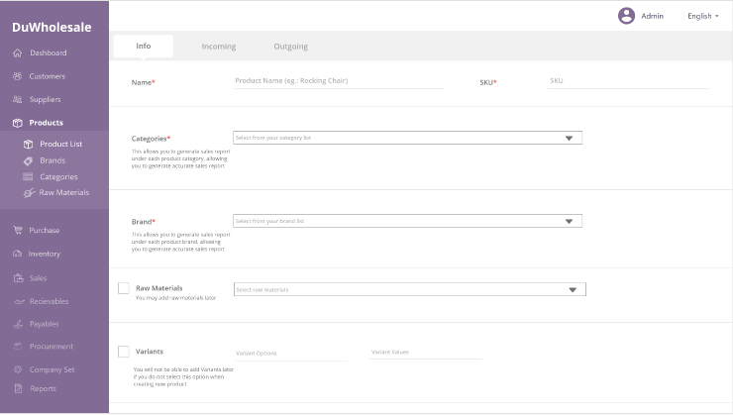
DuWholesale
Product Management
Comprehensive product information
Variant Management
Batch and expiry
Raw material management

Slide 7
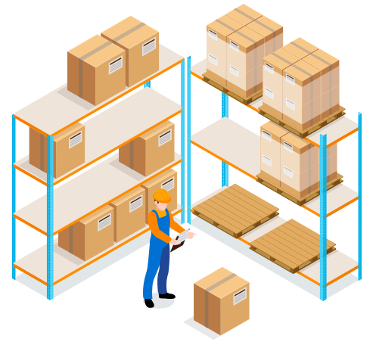
DuWholesale
Integrated
warehouse management
Real-time insight
Reducing the risk of miskicks
Reduce your processing costs
Reduce order fulfillment latency
Save time with automated shipping

Slide 8
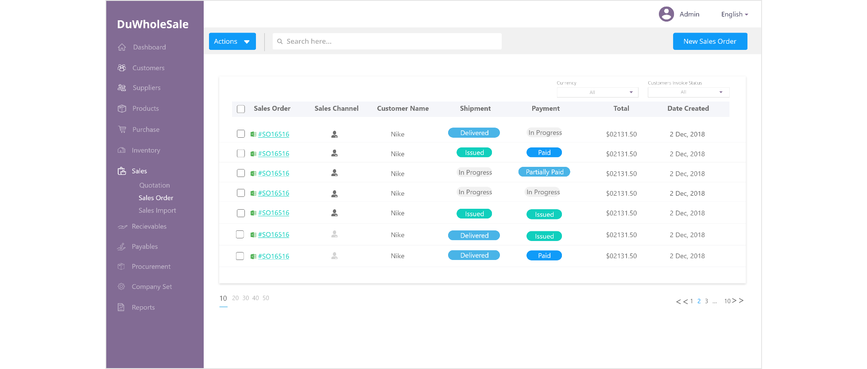
DuWholesale
Order management
Product Catalog management
Multichannel order management
Flexible returns management
Accounting integrations
Real-time sales profitability
Integrate with e-Commerce platforms

Slide 9
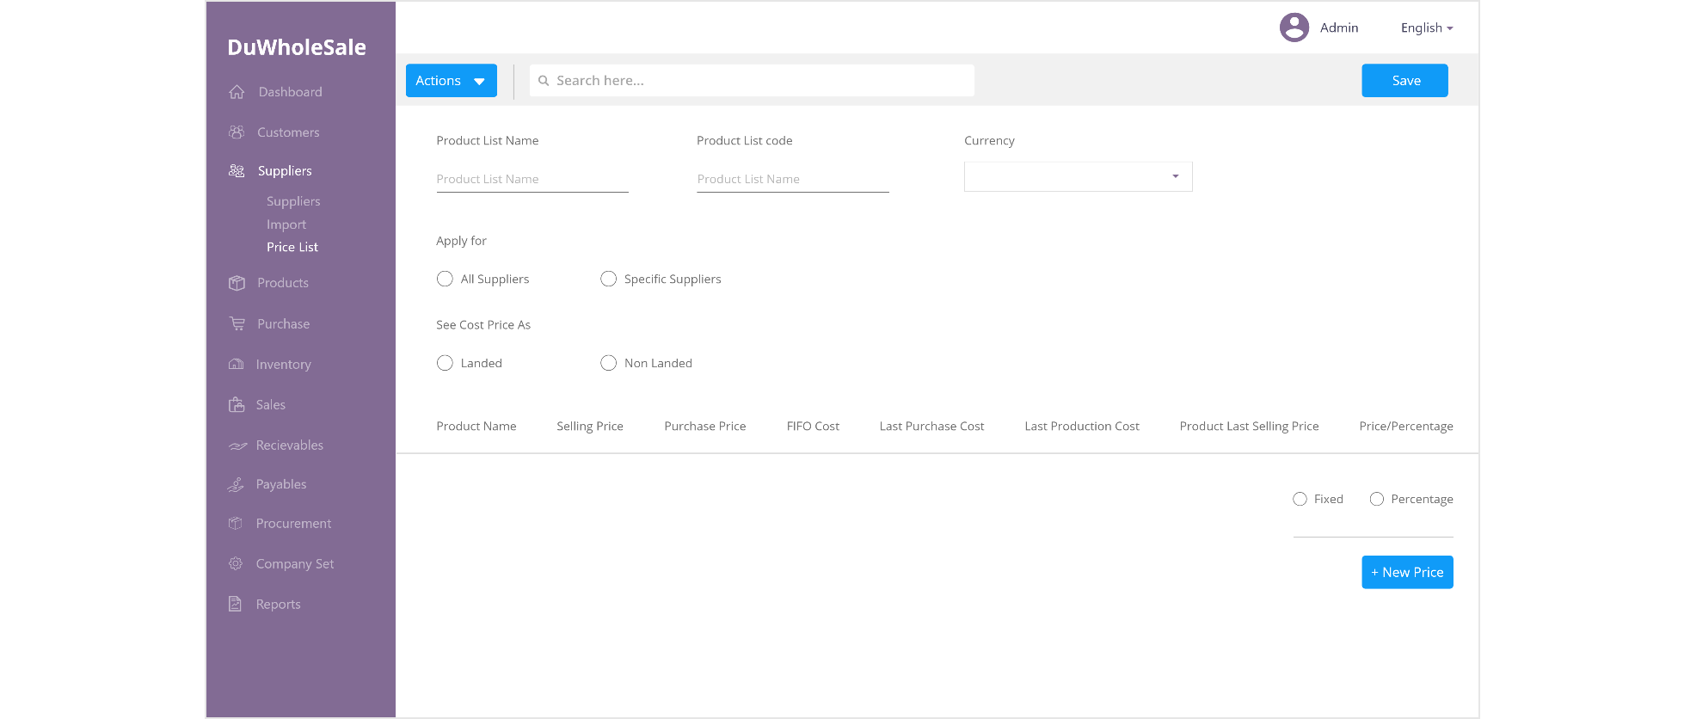
DuWholesale
Purchase and Supplier
Management
Centralized purchase order management
Multi-location purchasing & deliveries
Accounts payable management
Forecast demand effectively

Slide 10
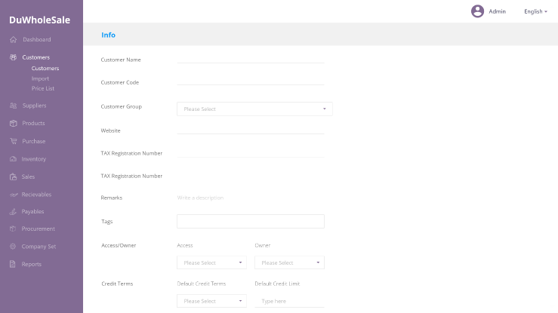
DuWholesale
Integrated CRM
Track Customer
Build Customer data
Automated email marketing
Improve your customer service
Target your marketing campaigns

Slide 11
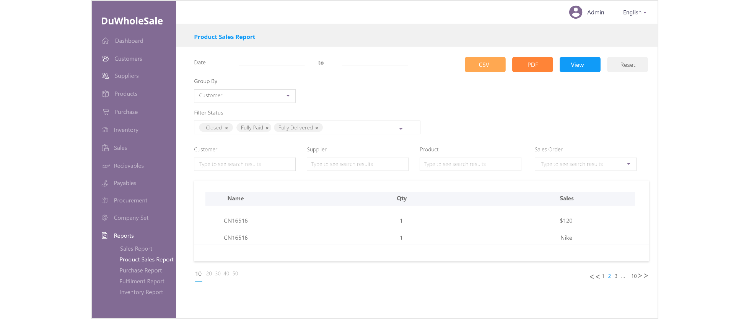
DuWholesale
Reports
Sales Report
Purchase Report
Inventory report
Fulfillment report
Filter through
Export report in CSV or PDF

Slide 12
Technology Stacks
Framework
Database
Web Server
Cloud

